Slide 1

ECE 281
Lesson 4
Maj Kevin Walchko
1

Slide 2
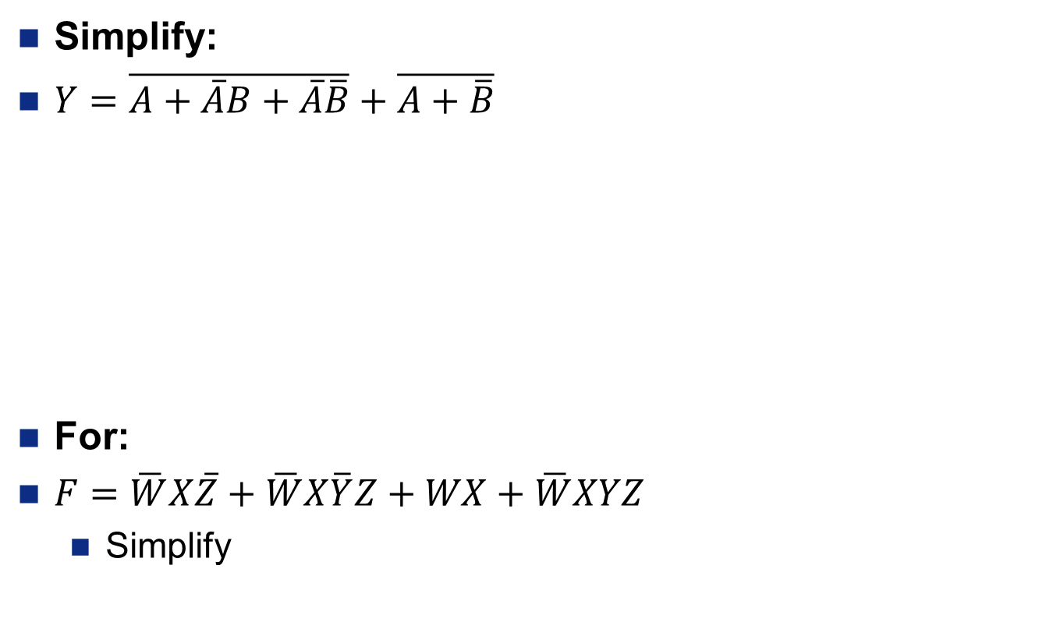
Review
Simplify:
$Y=\overline{A+\overline{A}B+\overline{A}\overline{B}}+\overline{A+\overline{B}}$
For:
$F=\overline{W}X\overline{Z}+\overline{W}X\overline{Y}Z+WX+\overline{W}XYZ$
Simplify

Slide 3
Priority Circuit
Inputs:
B – Col Butler
D – Dean
S – Superintendent
Outputs:
Y2 – Meet w/ Sup
Y1 – Meet w/ Dean
Y0 – Meet w/ Butler
S | D | B | Y2 | Y1 | Y0
0 | 0 | 0
0 | 0 | 1
0 | 1 | 0
0 | 1 | 1
1 | 0 | 0
1 | 0 | 1
1 | 1 | 0
1 | 1 | 1

Slide 4
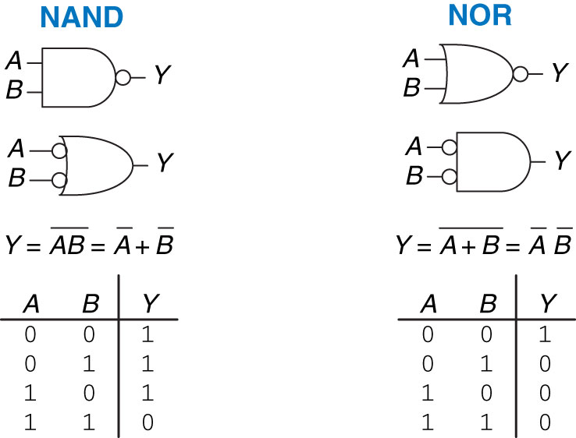
Bubble Pushing (De Morgan)
Why do this? It is easier to write equations when the bubbles are at the inputs

Slide 5
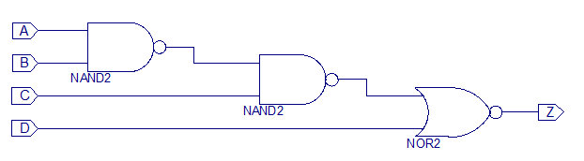
Bubble Pushing - Example
Process:
Start at output and work to input
Push bubbles as you go

Slide 6
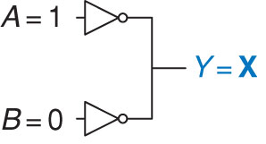
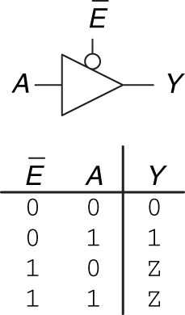
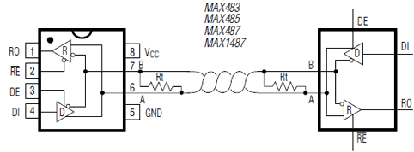
Tristate Buffer – High Impedance (Z)
Illegal, can’t tie to independent lines together!!
Tristate buffer however allows us to do this by disconnecting the line
RS 485 Half duplex communications

Slide 7
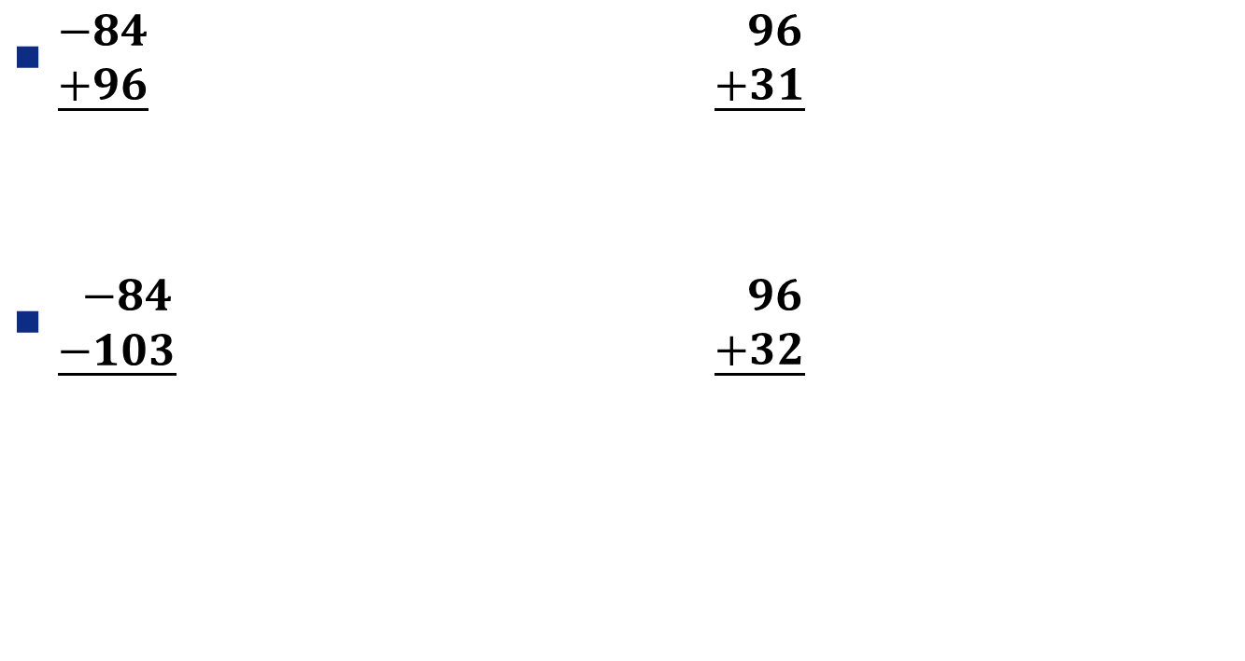
Math in Dec and Binary – Using an 8-Bit System
$\underline{\begin{aligned}−84 \\ +96\end{aligned}}$ $\underline{\begin{aligned} 96 \\ +31\end{aligned}}$
$\underline{\begin{aligned} −84 \\ −103\end{aligned}}$ $\underline{\begin{aligned} 96 \\ +32\end{aligned}}$

Slide 8
backup

Slide 9
CE 1 Good and Bad
Descriptive title
Objectives or purpose – what is the goal of this assignment?
Preliminary design and diagrams – how will you start attacking the problem?
Testing procedures and data collected – this is important! What you did, why you did it, what results you achieved, and how you know those results validate your work are vital to this section.
Debugging discussion – what problems did you face? How were they solved? Did you learn anything during this process?
Answers to Lab Questions
Observations and Conclusions – during this whole assignment, what did you learn? What did you notice that was noteworthy?
Documentation statement – always include this. Any help received on any portion of the assignment, even from an instructor or the internet should be specifically mentioned.

Slide 10
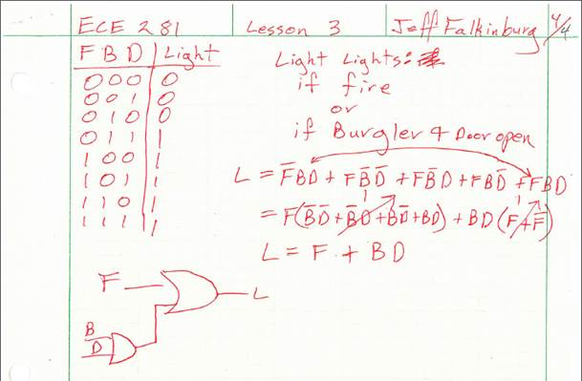
Example from Lesson 3
Given: A house alarm with fire, burglar, and open door alerts. You want to raise the alarm is there is a fire or if there is a burglar and an open door.
Draw the associated truth table, write a logic expression, and draw the logic circuit to represent this scenario.

Slide 12
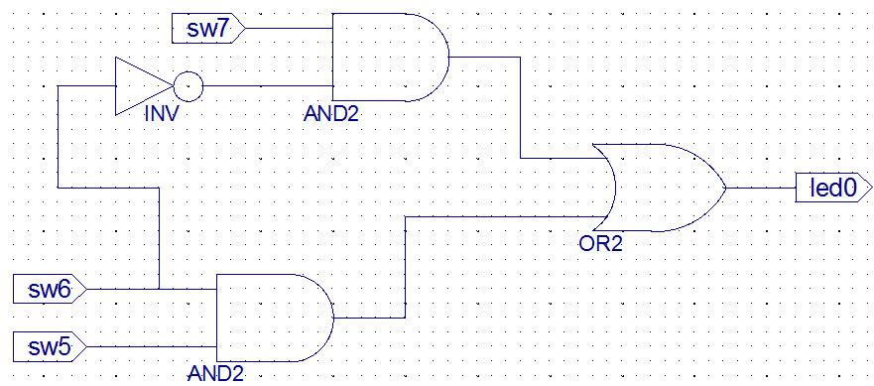
CPX-1 Schematics

Slide 13
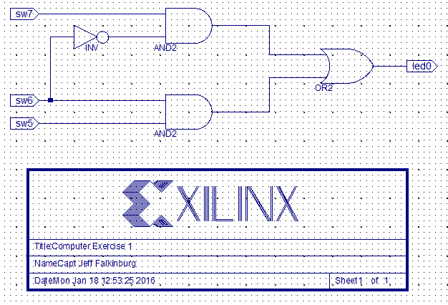
CPX-1 Schematics

Slide 14
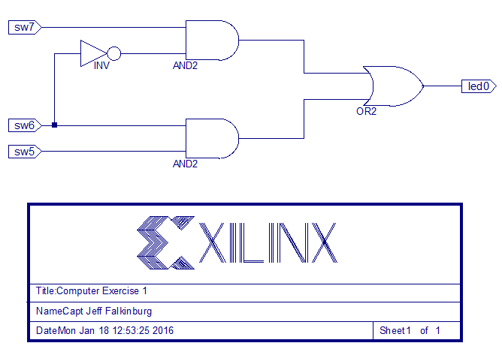
CPX-1 Schematics

Slide 15
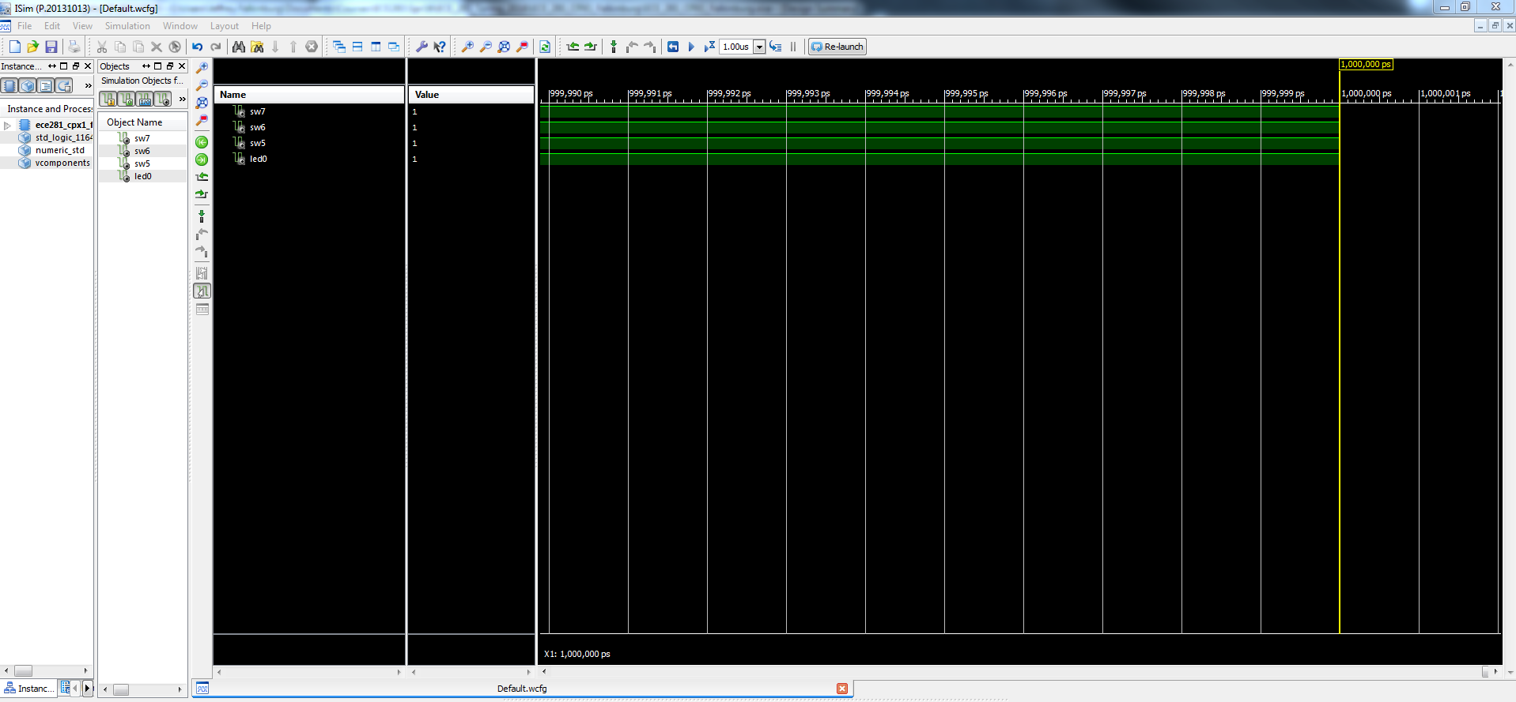
CPX-1 Simulation Waveform

Slide 16
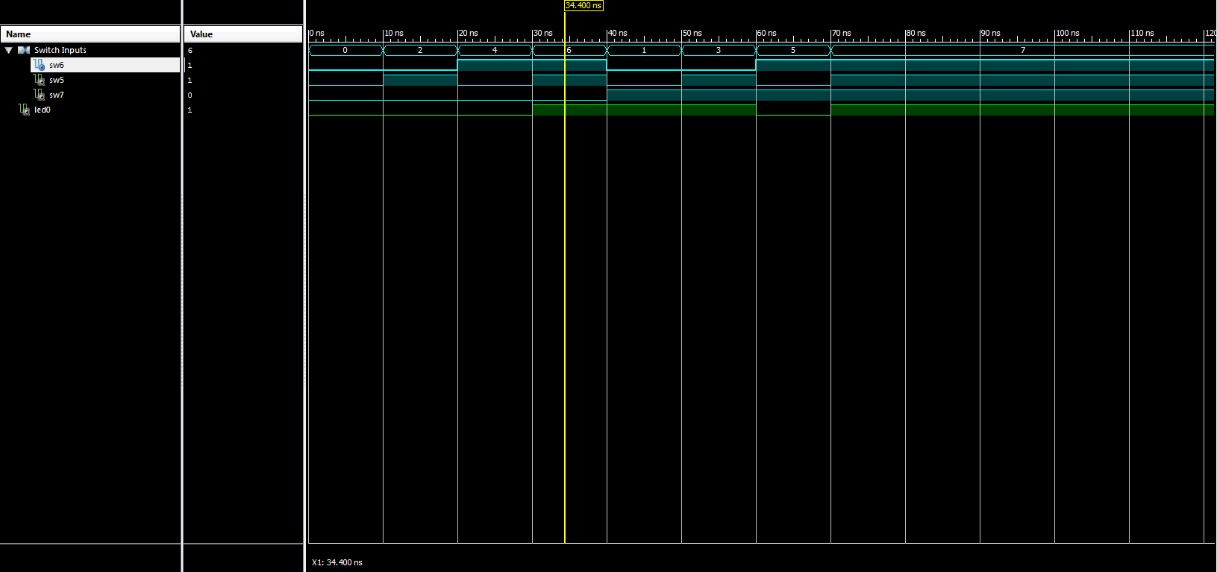
CPX-1 Simulation Waveform

Slide 17
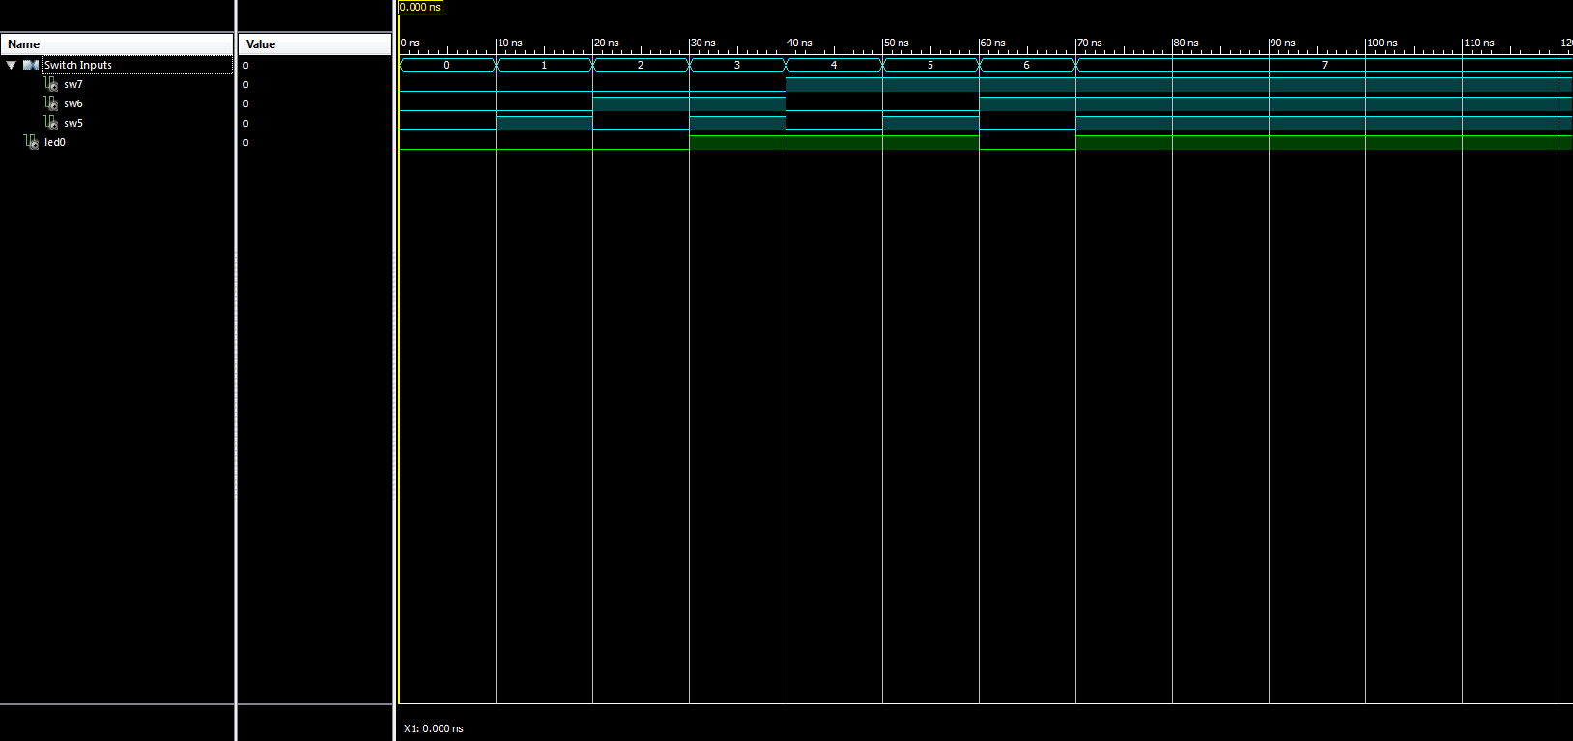
CPX-1 Simulation Waveform

Slide 18
CPX 1 Simulation Demo

Slide 19
CPX 1 Debugging
Be very descriptive with all the issues you encountered and their fix action was
Lab Notebook should be a conversation of what happened

Slide 20
CPX 1 Debugging
This lab was frustrating as it was my first time working with the software and we've had only a few hours of class discussing marginally related topics. Sometimes the defaults weren't the same as the step-by-step guide so I had to figure out what was wrong on my own and then figure out how to fix the problems. I suppose I got to learn a bit but the software filled up my computer and was not as user friendly as Google. Error messages were rarely helpful but I found that by repeating procedures (as in rewriting my progress) helped me find things to fix or fix them accidentally. Again, although I'd say I learned a lot I would guess that the teacher and other students won't be able to see my struggle as it probably worked flawlessly for them. It's like when you paddle in the water knowing you're supposed to get to the other side on your own but after a few miles you just want to call out to the boat alongside you and say "ho! let me up!" whereupon you find all your peers who have already reached the other side and are now on a cruise. But such is learning. If this lab journal is meant to be more formal please let me know and I will correct it. It's maybe 6-7 hours in and I am very done with trying to push through stubborn systems so a bit of venting in the debugging section seems more than called for. To sum up, the biggest problems I faced were things not being where they needed to be and me solving that by navigating menus to find what I needed. The professors were very helpful in solving problems.

Slide 21
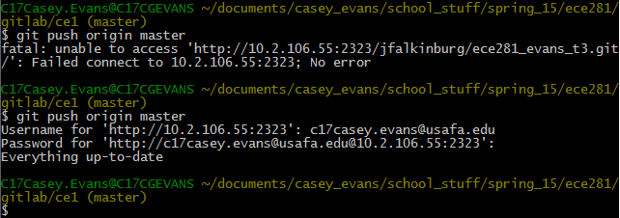
CPX 1 Debugging
Debugging GitLab took quite a few tries until I got somewhat used to the system. Issues involved internet access, typographical errors, and understanding the system.

Slide 22
CPX 1 Debugging – Common Errors
File Association - Schematic needs to be associated with All (i.e implementation and simulation)
Not selecting the testbench when running Simulation – getting X’s on the inputs and outputs of waveform.
Not doing a Git add before the Git commit and Git push
Out of order signals on waveform.
Images not showing up online (image path is case sensitive)
![Name of picture](images/image_name.PNG)

Slide 23
CPX 1 Hardware Demo
The FPGA functioned as expected…
What did you expect?
Reasonably prove to me that you accomplished the exercise!
Submit .bit file via GitLab
Screen shot of Successfully Programmed
Board Picture showing Input/Output combinations with explanation
Or Video

Slide 24
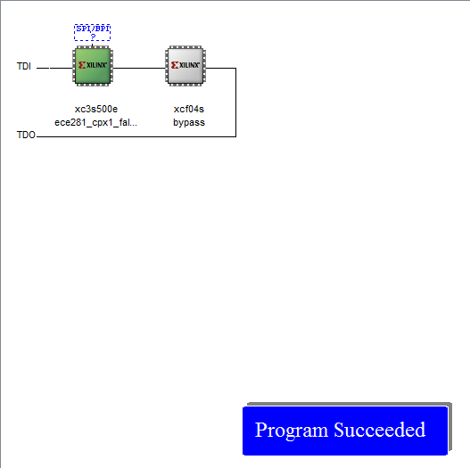
CPX 1 Hardware Demo

Slide 25
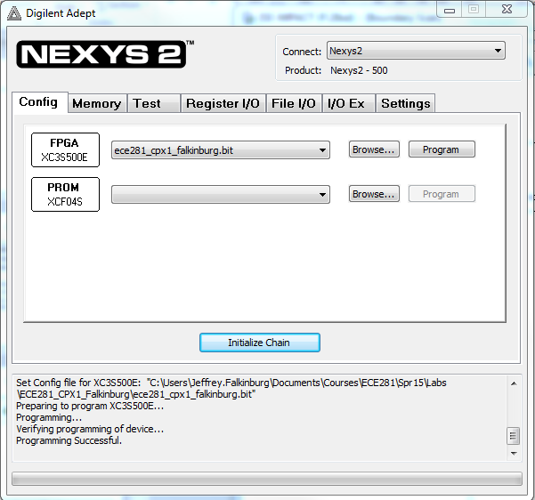
CPX 1 Hardware Demo

Slide 26
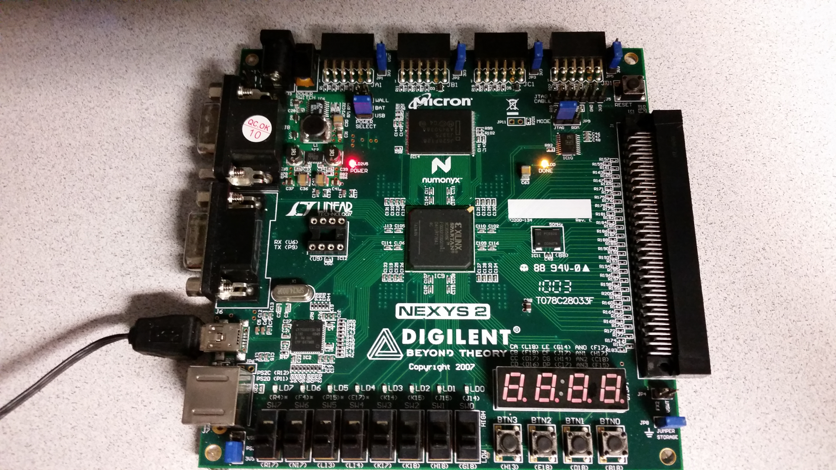
CPX 1 Hardware Demo

Slide 27
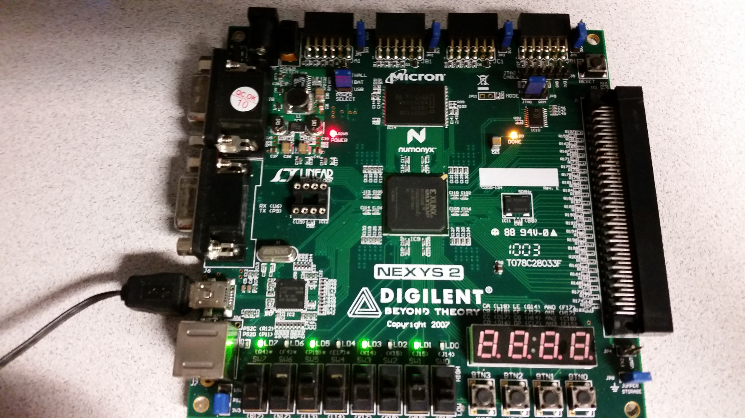
CPX 1 Hardware Demo

Slide 28
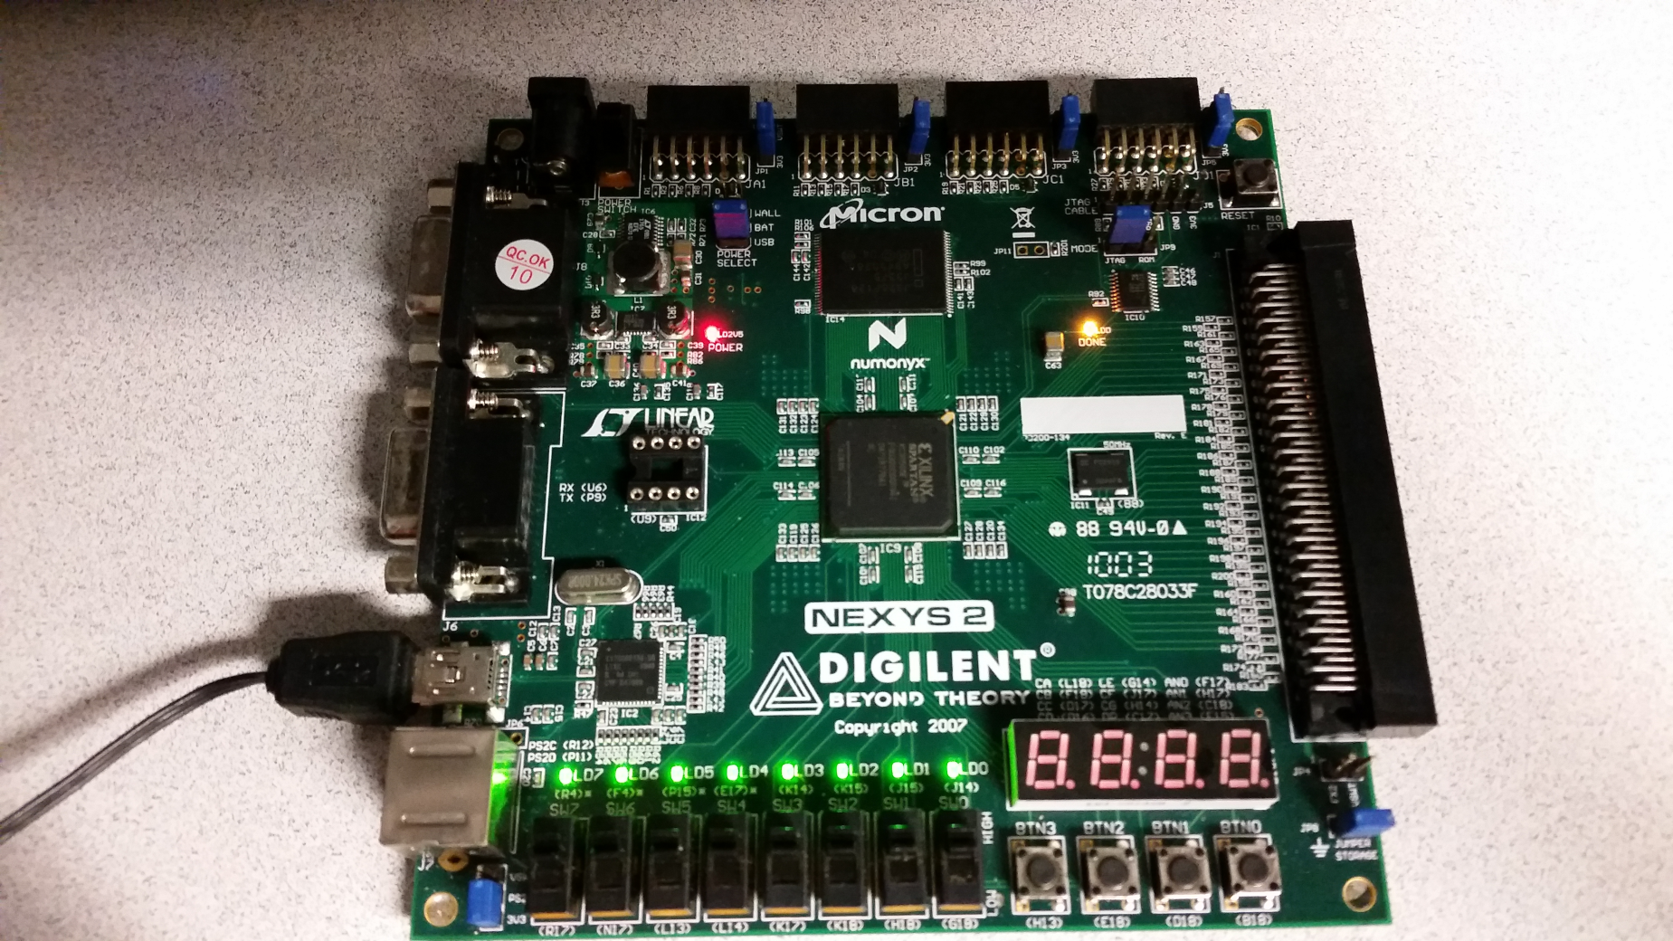
CPX 1 Hardware Demo

Slide 29
CPX 1 Conclusions
In this computer exercise I learned the steps in implementing a design. I learned not to just jump into implementing the design. A design stage is first needed, and then a simulation stage before the design can be implemented. I also learned how to use Linux software, as I have never used it before this exercise. Furthermore, I gained somewhat an understanding of gitlab, as well as how to write lab journals and use wiki and Markdown language.

Slide 30
CPX 1 Conclusions
During the assignment, I became familiar with creating a schematic on ISE Design Suite and using the software to create a simulation to test the schematic and then implement it on an FPGA board. Additionally, I became familiar with using GitLab to save my project files and uploading them to the project file. The most noteworthy portion of the lab were the commands for GitLab mentioned in the Debugging Discussion paragraph.

Slide 31
CPX 1 Code Header
--------------------------------------------------------------------
-- Name: <Your Name>
-- Date: <The date you stated working on the file>
-- Course: <The course's name>
-- File: <This file's name>
-- HW: <HW# and name>
--
-- Purp: A brief description of what this program does and
-- the general solution strategy.
--
-- Documentation: <list the names of the people who you helped>
-- <list the names of the people who assisted you>
--
-- Academic Integrity Statement: I certify that, while others may have
-- assisted me in brain storming, debugging and validating this program,
-- the program itself is my own work. I understand that submitting code
-- which is the work of other individuals is a violation of the honor
-- code. I also understand that if I knowingly give my original work to
-- another individual is also a violation of the honor code.
-------------------------------------------------------------------------

